Slide 1
Desktop publishing
Units 13

Slide 2
Agenda
01
02
03
04
Learn about desktop publishing
Understand the purpose and benefits of using DTP software;
Use degrees of adjectives to describe the process;
Learn specific terms related to the topic

Slide 3
Let’s talk about these questions
2. What skills are needed in publishing?
1. What do you know about desktop publishing?

Slide 4
1. Offset lithography is a common form of printing. 2. Electronic paper is a special digital screen that can be read like paper. 3. Electrostatic printing is a method that uses the forces of electricity to print.

Slide 5
4. Clip art is electronic artwork that can be used in publications. 5. Page layout is the process of arranging text and graphics on a page. 6. Desktop publishing software is a computer program that is used to make page layouts.

Slide 6
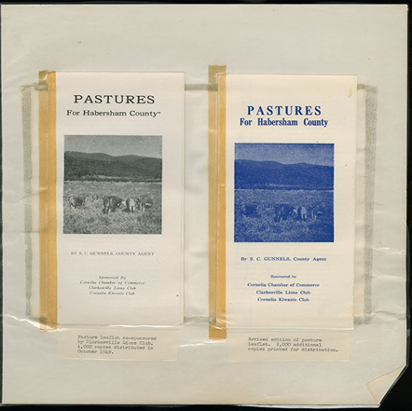
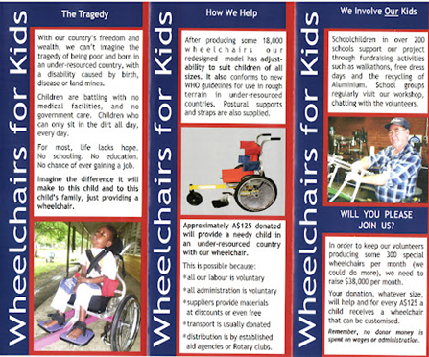
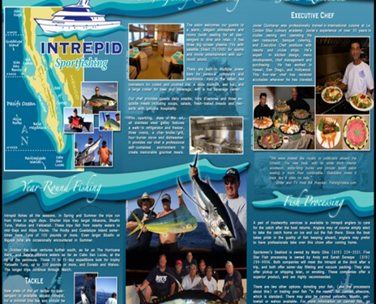
Analysis and discussion
Examine the printed documents. Analyze the design elements such as layout, typography, use of images, color scheme, and overall visual appeal.

Slide 7
Grammar Focus: Degrees of adjectives
An adjective is a word that describes, qualifies, modifies, or quantifies nouns or pronouns. There are three degrees of adjectives that compare one item to another. These three degrees of adjectives reflect the strength of the adjective.

Slide 8
Adjectives with a Single Syllable:
When two items or people are contrasted, the extension ‘er’ is used for the adjective in conjunction with the word ‘than’ to create a comparative degree of the adjective. Only the letter ‘r’ is added to adjectives that end in an ‘e’. When comparing more than two items or people, the superlative degree is created by adding the word ‘est’ to the adjective. Only ‘st’ is added to words ending in ‘e’.

Slide 9
Example: Subnotebooks are smaller than laptops.
Positive Adjective - the basic form of an adjective. It simply implies the presence of a quality. | Comparative - when comparing one noun or pronoun to another, comparative degree is applied. | Superlative - in comparison to other things, it represents the utmost intensity (quality or quantity) of a thing.
smart weak late | smarter weaker later | the smartest the weakest the latest

Slide 10
When an adjective ends in a consonant + vowel + consonant, we double the consonant and add -er for the comparative form, and we double the consonant and add est for the superlative form. Examples:
• big – bigger – biggest
• hot – hotter – hottest
• thin – thinner – thinnest
We omit the y and add - ier for the comparative form and - iest for the superlative form when the adjective ends in consonant + y.
Examples:
• dirty – dirtier – dirtiest
• ugly – uglier – ugliest

Slide 11
Two or More-Syllable Adjectives
We add the word more to produce a comparative form and more to form a superlative form when the adjective is lengthy, i.e. two or more syllables.
Positive | Comparative | Superlative
useful beautiful important | more useful more beautiful more important | the most useful the most beautiful the most important
Example: A laptop is more compact than a desktop computer.

Slide 12
Irregular Degree of Adjectives
There are a few adjectives that don’t have comparative or superlative versions. They do not adhere to any rules. Examples:
• good – better – best
• bad – worse – worst
• much – much – most
• little – less – least
• far – farther – farthest

Slide 13
Choose the correct form (comparative or superlative) of the adjective in parentheses to complete each sentence.
1. Python is (popular) ______ than Ruby among data scientists.
2. This algorithm is (efficient) ______ than the previous one we used.
3. JavaScript is (widely used) ______ for front-end development.
4. Artificia Intelligence is (complex) ______ field of study in computer science.
5. HTML is (basic) ______ language used for creating web pages.
6. Java is (versatile) ______ language because it can run on different platforms.
7. Cybersecurity threats are becoming (sophisticated) ______ over time.
8. Machine learning models are becoming (advanced) ______ in analyzing big data.
9. C++ is (fast) ______ than Python in terms of execution speed.
10. Blockchain technology is considered (secure) ______ than traditional databases.

Slide 14
Answers: 1. more popular; 2. more efficient; 3. widely used; 4. the most complex; 5. the basic; 6. a versatile; 7. more sophisticated; 8. more advanced; 9. faster; 10. more secure.

Slide 15
Read the sentence pairs. Choose which word or phrase best fits each blank.
electronic pages/ electronic paper
A) Many books are available on ___________. B) Desktop publishing specialists assemble ______________ .
Clip art / page layout
2. A) If you need an extra picture use __________. B) That _________ looks complete.
Offset lithography / electrostatic printing
3. A) ___________ is all done with machines. B) ____________ uses oil and water to transfer ink.

Slide 16
Read the following text and answer the questions.
Welcome to our lesson on Desktop Publishing (DTP), where we dive into the world of digital design and graphic communication. Desktop publishing revolutionizes how we create and present content, allowing us to meticulously craft electronic pages with comprehensive layouts. Whether you're designing a sleek brochure, an eye-catching poster, or a polished newsletter, DTP tools empower you to merge text and visuals seamlessly. Understanding the principles of typography, color theory, and layout composition is key to producing professional-grade materials that captivate and inform your audience effectively. Join us as we explore the art and science of desktop publishing, where creativity meets precision in digital design.

Slide 17
1. What is Desktop Publishing (DTP)?
A. Creating documents using traditional printing methods
B. Designing electronic pages with text and visuals
C. Writing code for web development
D. None of the above
2. What does DTP allow you to do?
A. Create comprehensive layouts
B. Edit videos
C. Perform complex mathematical calculations
D. All of the above

Slide 18
3. Which of the following is important in DTP?
A. Understanding of color theory
B. Learning to play musical instruments
C. Mastering cooking techniques
D. A and B only
4. How does DTP contribute to graphic communication?
A. By simplifying text editing
B. By combining text and visuals effectively
C. By automating social media posts
D. By designing computer hardware
5. Why is understanding typography essential in DTP?
A. To become a professional chef
B. To create visually appealing documents
C. To repair cars
D. None of the above

Slide 19
Answers: 1. B. Designing electronic pages with text and visuals 2. A. Create comprehensive layouts 3. A. Understanding of color theory 4. B. By combining text and visuals effectively 5. B. To create visually appealing documents

Slide 20
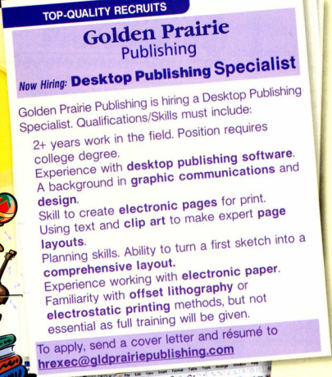

Slide 21
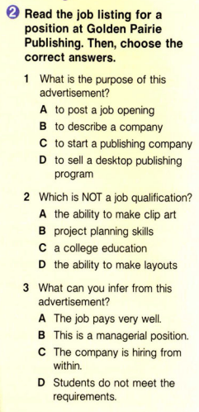
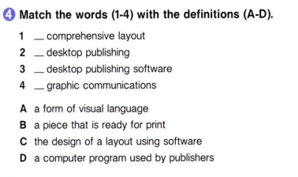

Slide 22

Listen to a candidate's interview for a desktop publishing job. Mark the following statements as either True or False.
1. The candidate works with electronic paper.
A. True
B. False
2. The candidate is in college.
A. True
B. False
3. The candidate creates layouts.
A. True
B. False

Slide 23
Listen again and complete the conversation.
Ben: Good morning, please take a 1) __________.
Jamie: Hello, it's nice meeting you.
Ben: Right! I see you have a degree in 2) ________ _________. Do you have experience creating 3) ___________?
Jamie: Yes. I work with desktop 4) _______ ___________ every day.
Ben: What type of work do you do? I want to hear more.
Jamie: I combine text with graphics to create 5) ________ _________.
Ben: Interesting. Do you ever work with 6) _________ _________?
Jamie: Fairly often actually. I think it's the future of publishing.
Answers: 1. seat; 2. graphic communications; 3. layouts; 4. publishing software; 5. electronic pages; 6. electronic paper

Slide 24
Checking Comprehension Questions (CCQ):
How does the layout contribute to the overall effectiveness of the design?
What role does typography play in conveying the intended message?
How might Desktop Publishing software have been used to create the design?
What improvements or changes would you suggest to enhance the design?

Slide 25


Slide 26
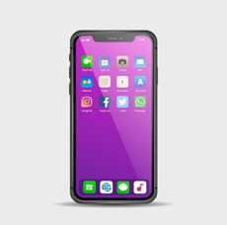
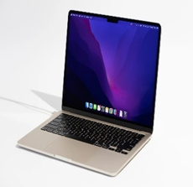
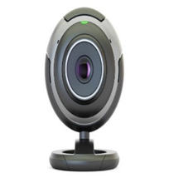
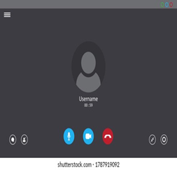
Guess the Topic
Guess what each picture represents and how they are related to today’s topic.

Slide 27
Videoconferencing Unit 14

Slide 28
AGENDA
2.
3.
1.
Constructing polite requests and offers using modal verbs ("can" and "could") in the context of videoconferencing interactions;
Using key vocabulary related to videoconferencing effectively in spoken communication;
Identifying the correct use of modal verbs can and could in sentences related to videoconferencing scenarios.

Slide 29
Let’s discuss these questions
1. What is videoconferencing?
2. What can video conferencing be used for?

Slide 30

Watch the video and find out 3 tips of video conferencing

Slide 31
Grammar Focus: Can and Could
Can and could modal verbs are used to discuss abilities, permissions, suggestions, and polite requests. Here are some examples:
Using “Can”:
1. Ability:
"With a stable internet connection, we can conduct videoconferences with clients worldwide."
"You can share your screen during the video call to give everyone a visual reference."
2. Permission:
"Participants can join the meeting at any time using the provided link."
"Can I record this meeting for future reference?"

Slide 32
3. Possibility:
"We can schedule regular videoconferences to keep everyone updated."
"You can use virtual backgrounds to maintain professionalism during the call."
4. Offering Help:
"I can assist you with setting up the video conferencing software if needed."
"Can I help troubleshoot any issues you're having with your webcam?"

Slide 33
Using “Could”:
1. Polite Request:
"Could you please mute your microphone when you're not speaking to reduce background noise?"
"Could we start the meeting a few minutes later? I'm waiting for one more participant to join."
2. Suggestion:
"We could use breakout rooms for smaller group discussions during the videoconference."
"You could try adjusting the lighting in your room to improve the video quality."
3. Past Ability or Permission:
"Last month, we could only have audio calls, but now we can do video calls as well."
"In the previous system, we could only host up to 10 participants in a videoconference."
4. Hypothetical Situation:
"If we could improve our bandwidth, our videoconferences would be much clearer."
"Could we consider using a different platform if this one continues to have connectivity issues?"

Slide 34
Choose the correct modal verb ("can" or "could") to complete each sentence.
1. ____ you please share your screen so we can see the presentation?
A) Can
B) Could
2. Last week, we ____ only have audio calls, but now we have upgraded to video calls as well.
A) can
B) could
3. ____ we use breakout rooms for smaller group discussions during the videoconference?
A) Can
B) Could
4. If we ____ improve our internet connection, our video calls would be much clearer.
A) can
B) could
5. I ____ assist you with setting up the video conferencing software if needed.
A) can
B) could
6. ____ you please mute your microphone when you're not speaking to reduce background noise?
A) Can
B) Could
7. We ____ schedule regular videoconferences to keep everyone updated.
A) can
B) could
8. ____ I help troubleshoot any issues you're having with your webcam?
A) Can
B) Could

Slide 35
4. If we ____ improve our internet connection, our video calls would be much clearer.
A) can
B) Could
5. I ____ assist you with setting up the video conferencing software if needed.
A) can
B) Could
6. ____ you please mute your microphone when you're not speaking to reduce background noise?
A) Can
B) Could

Slide 36
7. We ____ schedule regular videoconferences to keep everyone updated.
A) can
B) could
8. ____ I help troubleshoot any issues you're having with your webcam?
A) Can
B) Could
Answers: 1. B) Could; 2. B) could; 3. A) Can; 4. B) could; 5. B) could; 6. B) Could; 7. A) can; 8. A) can

Slide 37
Try to turn the following statements from impolite to polite.
Example:
Impolite: "Can you speak up? I can't hear you."
Polite: "I'm sorry, could you please speak a bit louder? It's a bit difficult to hear you."
Impolite: "Stop interrupting me! Let me finish."
Polite: "I appreciate your input. Could I finish my thought before we move on?"

Slide 38
Impolite: "You're wrong about that. Let me explain it to you."
Polite: "I understand your perspective. Here's how I see it.“
Impolite: "That's a terrible idea."
Polite: "I see where you're coming from, but I'm not sure that idea aligns with our current goals.“
Impolite: "You never follow through on your commitments."
Polite: "I've noticed some challenges with completing tasks. Is there anything I can do to support you?"
Impolite: "This meeting is dragging on. Can we wrap it up?"

Slide 39
Put in order the following sentences to form a coherent dialogue that might occur during a teleconference. Number them from 1 to 5 in the correct order.
1. Speaker A: "Let's set up a follow-up meeting for next week to finalize the details."
2. Speaker B: "Sure, that works for me. How about Tuesday afternoon?"
3. Speaker A: "I think we need to consider how this will impact our timeline."
4. Speaker B: "I agree. It's important to assess all potential risks."
5. Speaker A: "Before we proceed, I'd like to discuss the potential challenges."

Slide 40
1. "Before we proceed, I'd like to discuss the potential challenges." 2."I think we need to consider how this will impact our timeline." 3."I agree. It's important to assess all potential risks." 4."Sure, that works for me. How about Tuesday afternoon?" 5."Let's set up a follow-up meeting for next week to finalize the details."
Answer key:

Slide 41
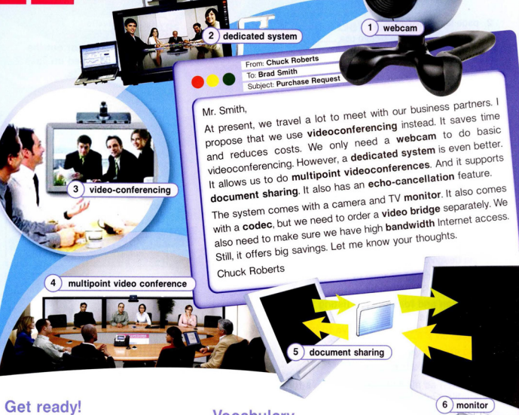

Slide 42
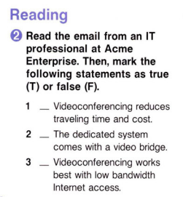
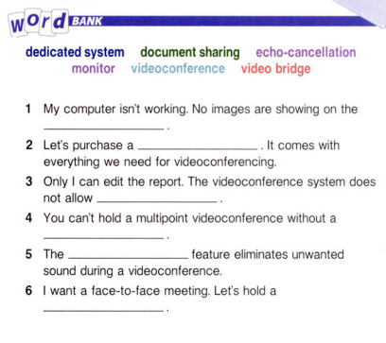

Slide 43
Write a word or phrase that is similar in meaning to the underlined part.
1. A high amount of information that a network sends and receives helps images load quickly on the Internet. (b _ n _ _ i _ _ h)
2. To set up a videoconference system, first connect the equipment that codes and reads signals. (c _ d _ _)
3. John attached a camera that broadcasts sound and video on the Internet. (w _ _ c _ m)
4. Our offices can hold a videoconference among people in different locations. (m _ _ t _ _ o _ n _) (v _ _ e _ _ _ n _ _ r _ _ _ _)

Slide 44
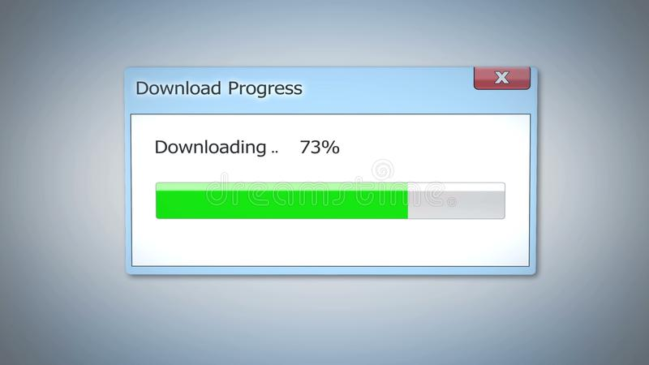
Extra activity will be provided soon

Slide 45
Revision of previous lessons’ terms
www.wordclouds.com

Slide 46

Listen to a conversation between the IT professional and a sales representative at Clearwater Technologies. Choose the correct answers.
1. What are the speakers mostly talking about?
A. what the benefits of videoconferencing are
B. what the IT professional wants to purchase
C. how to set up videoconference equipment
D. what the use of a video bridge is
2. What is the advantage of having two monitors?
A. It lets you hold multipoint videoconferences.
B. It enhances the sound and picture quality.
C. It comes with a video bridge.
D. It lets you do document sharing.

Slide 47
Listen again and complete the conversation.
Sales Representative: ClearWater Technologies. How can I help you?
IT professional: I want to purchase a 1) _______ system for 2) _________. What are my options?
Sales Representative: Well, we have systems with one or two TV 3) ____________ .
IT professional: What's the difference?
Sales Representative: The system with two TV monitors lets you hold 4) _________ ________.
IT professional: I need 5) ___________ TV monitors then. Does it come with a video bridge?
Sales Representative: No, you order that separately.
IT professional: Okay, then I need to order one 6) _______ ____________ as well, please.
Answers: 1. dedicated; 2. videoconferencing;3. monitors; 4. multipoint videoconferences; 5. two; 6. video bridge

Slide 48
Activity:
Write about the advantages and disadvantages of videoconferencing, and how videoconferencing is used in different industries.

Slide 49

Thanks!

Slide 50
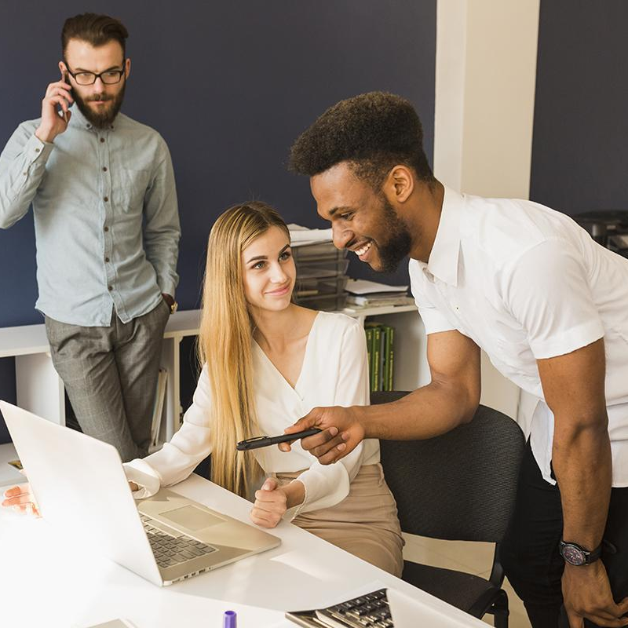
Draw! Guess! Find!

